Slide 1

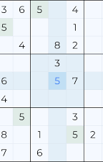
SUDOKU VALIDATOR

Slide 2
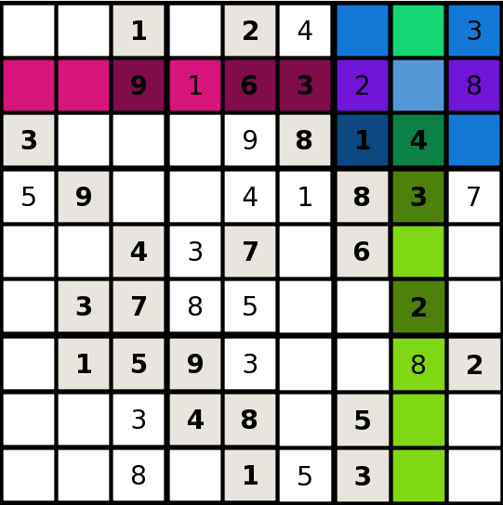
SUDOKU AND HOW IT IS PLAYED
Sudoku is a very popular Japanese puzzle game. It is a game of logic; It is based on the logical placement of numbers.
In this game, the player is given a 9x9 grid, divided into nine 3x3 sub-grids.
The user is provided with a few boxes of some sub-grids of the board already filled with numbers from 1 to 9, and the user has to complete it while following sudoku rules, which are:
➢ Only digits from 1 to 9 can be used.
➢ There should be no repetition of any digit in any row.
➢ There should be no repetition of any digit in any column.
➢ There should be no repetition of any digit in any 3x3 sub-grid

Slide 3
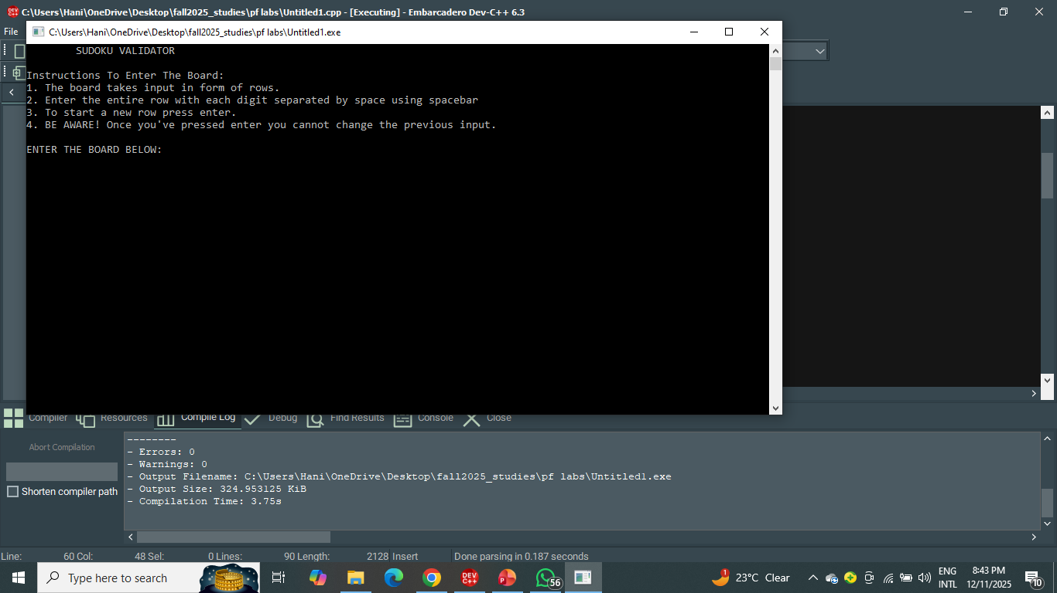
HOW A SODOKU VALIDATOR HELPS
As difficulty level of the puzzle increases manual validation becomes:
More time consuming.
More difficult.
More prone to errors.
Sudoku validator will help the player verify their board easily, within a few seconds and without human errors.

Slide 4
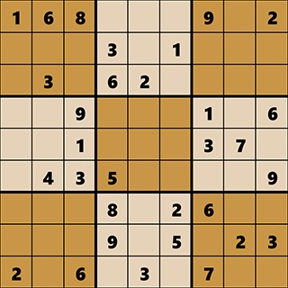
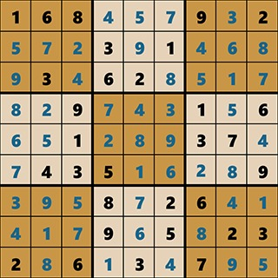
UNSOLVED:
SOLVED:

Slide 5
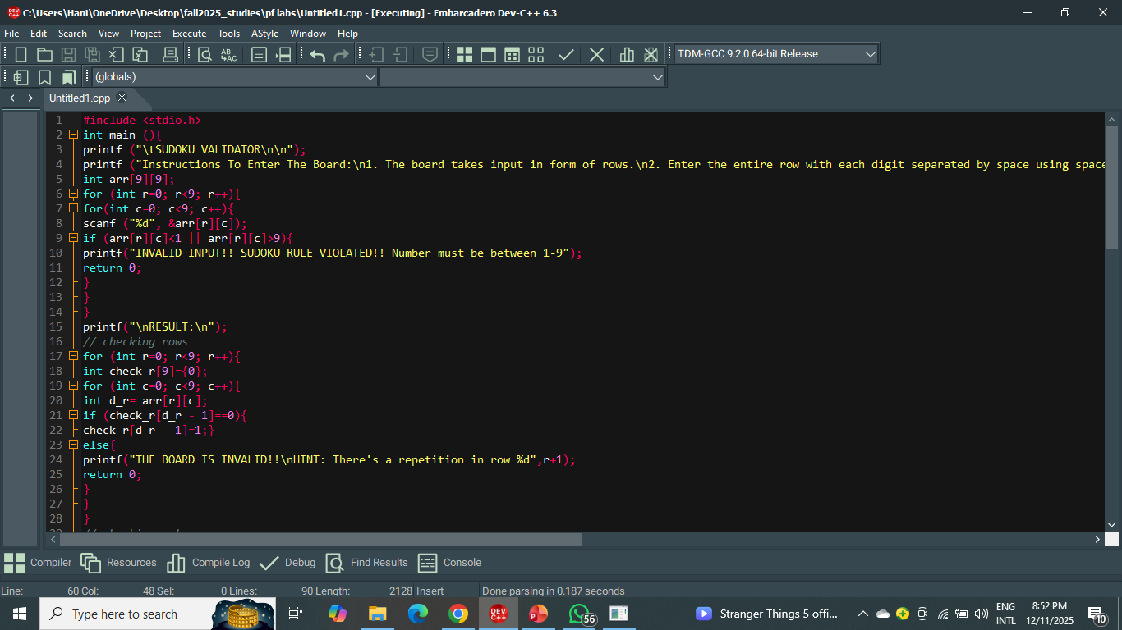
LET’S MOVE TO THE BACKEND OF THE SODOKU VALIDATOR…..

Slide 6
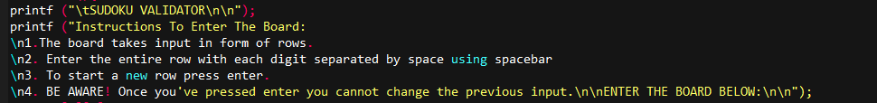
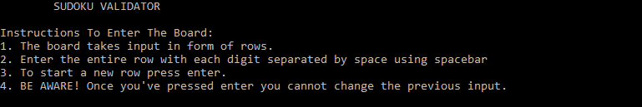
Step 1) Displaying the instructions to enter input.
CODE:
OUTPUT:

Slide 7
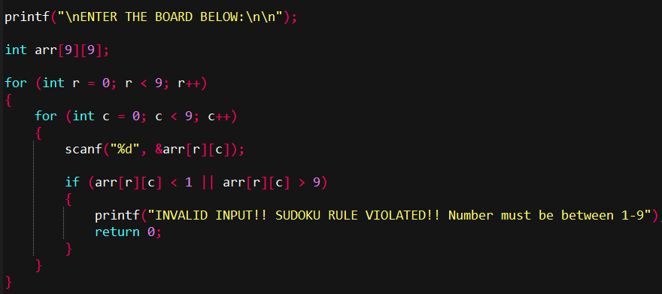
STEP 2) Taking the user’s Sodoku board as input.
Code:

Slide 8
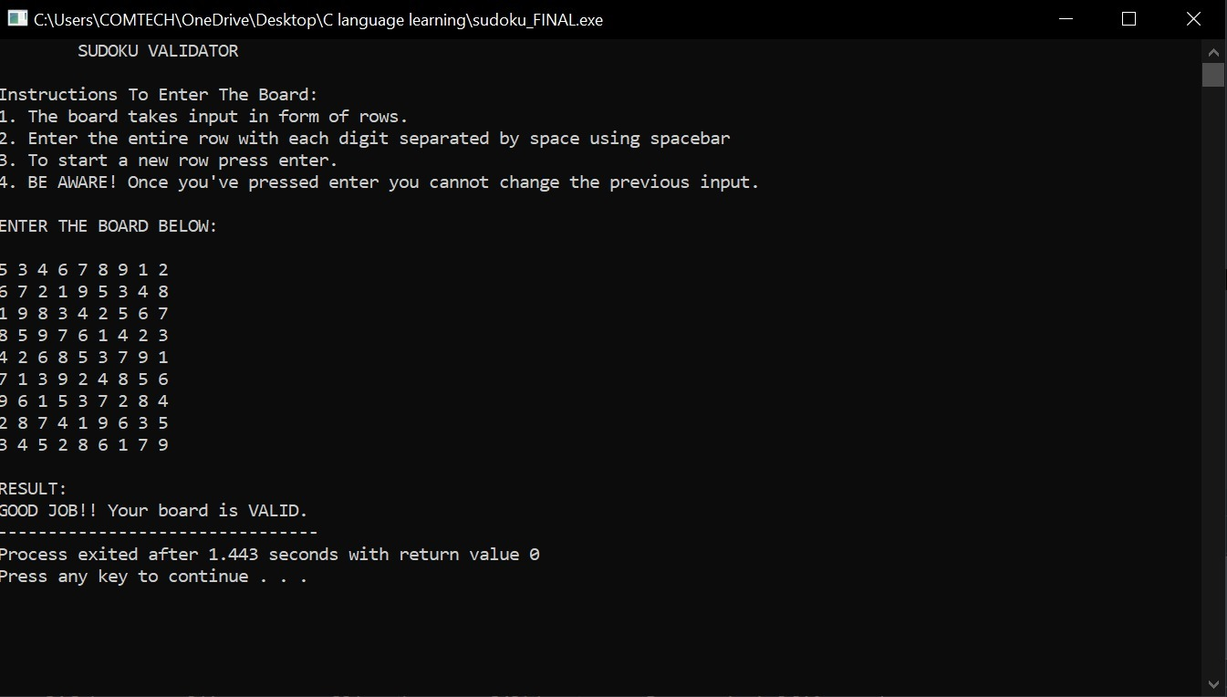
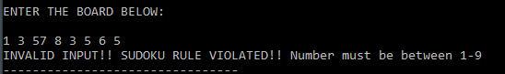
Output:
Output when input number is not in the range(1-9):

Slide 9
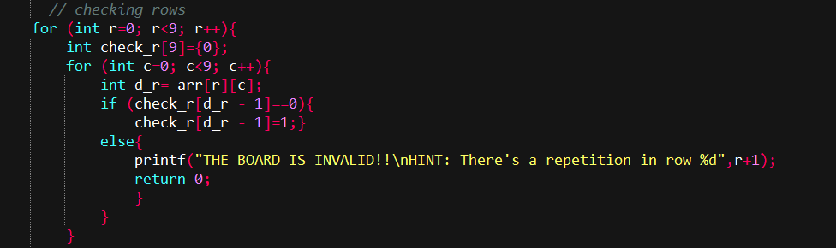
Step 3) Checking the rows of the entered Sodoku board to see if any element is repeating.
Code:

Slide 10
Logic behind checking repitition:
The array check_r[9] acts as a tracker for digits 1–9 in each row.
Since Sudoku digits range from 1–9, each digit can be mapped to an index in array check-r[9] using (digit-1)
For example: if an element of a row in the Sodoku board = 5 then its index in check_r[9] array = 4.
Each time a digit appears, the corresponding index in check_r is marked 1.
If the same digit appears again, that index will already be 1, meaning a repetition → invalid row.

Slide 11
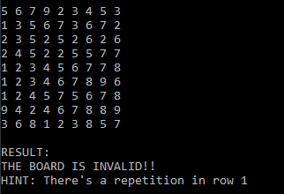
For example:
Example (Row = 3 1 4 5 6 7 8 9 2):
Start: check_r = {0,0,0,0,0,0,0,0,0}
After reading 3: mark index 2 : {0,0,1,0,0,0,0,0,0}
After reading 1: mark index 0 : {1,0,1,0,0,0,0,0,0}
If a number repeats (say another 3 appears), then check_r[2] would already be 1, triggering invalid message.

Slide 12
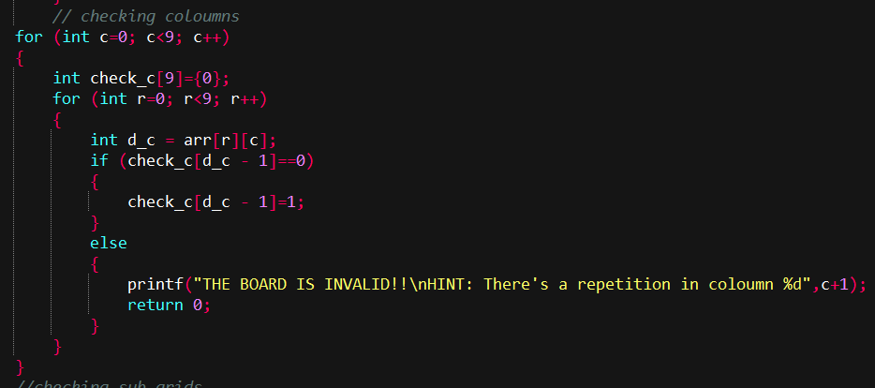
Step 4) Checking columns of the Sodoku for repetition.
Code:

Slide 13
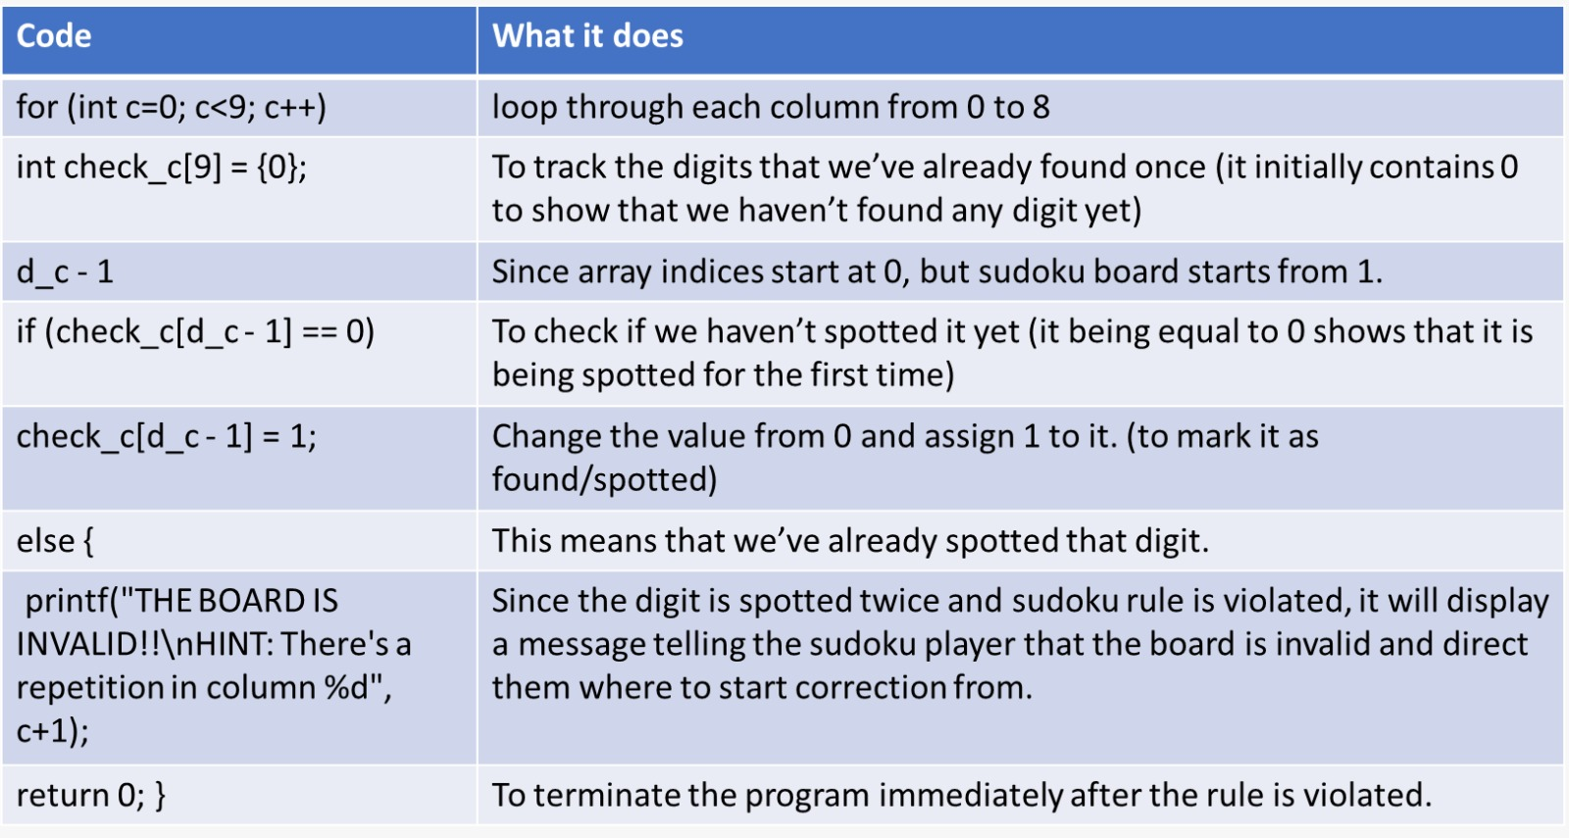

Slide 14
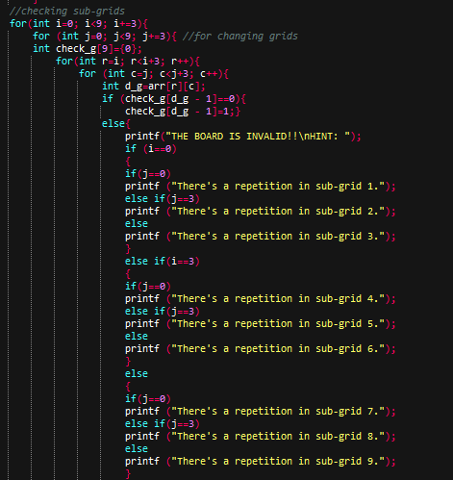
Step 5) Checking the sub-grids for repetition:
Code:

Slide 15
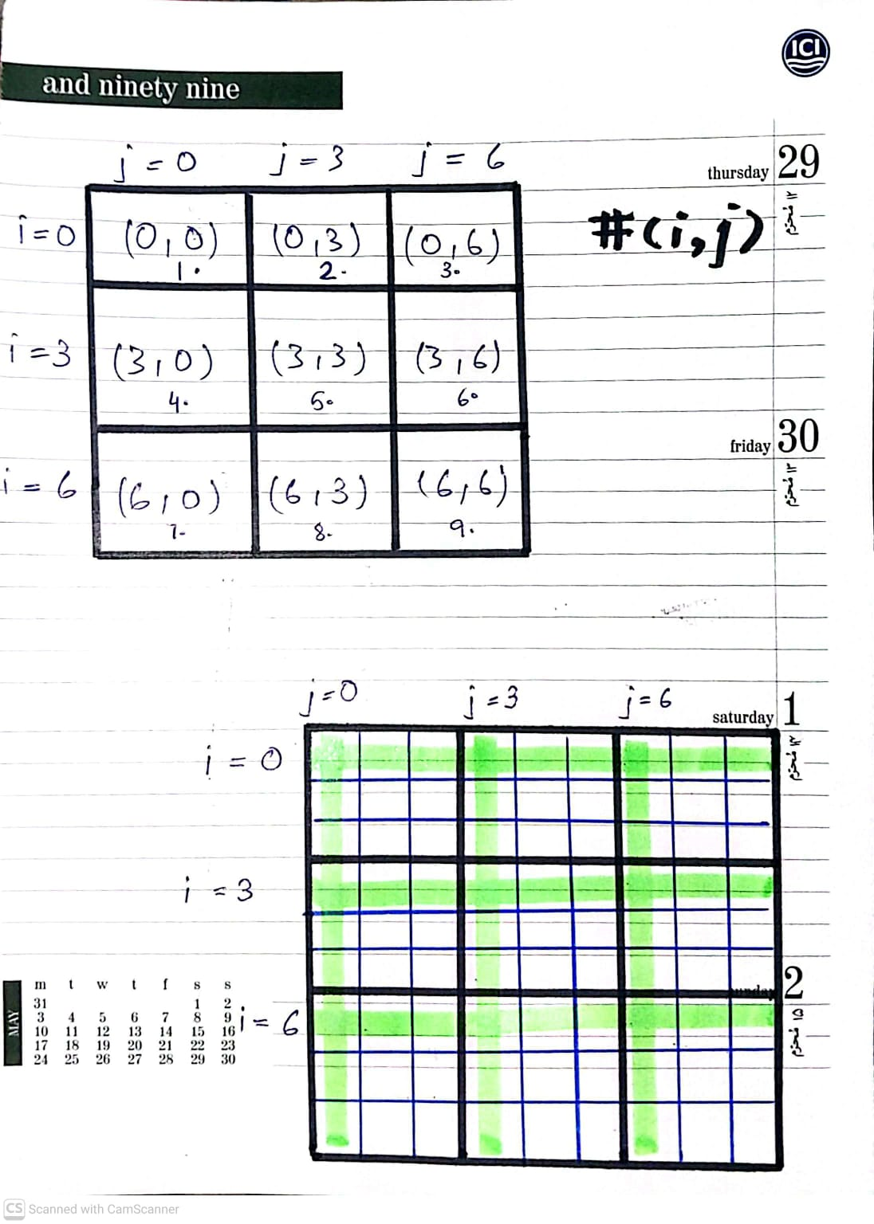

Slide 16
Important points:
This tool is only a Sodoku Validator, with the objective of verifying the entered Sodoku board. And showing if it is valid or not.
It is not necessary to enter the elements in the same manner as situated in the Sodoku board. User can enter in whatever way but using space in between is necessary.

